Slide 1
Chapter 4: NAT for IPv4
Notes:
Cisco Networking Academy Program
Routing and Switching Essentials v6.0
Chapter 9: NAT for IPv4

Slide 2
Chapter 4 - Sections & Objectives
4.1 Network Layer Protocols
  Explain how NAT provides IPv4 address scalability in a small to medium-sized business network.
4.2 Configuring NAT
  Configure NAT services on the edge router to provide IPv4 address scalability in a small to medium-sized business network.
4.3 Troubleshoot NAT Configurations
  Troubleshoot NAT issues in a small to medium-sized business network.
Notes:
2

Slide 3
4.1 NAT Operation
Notes:
Cisco Networking Academy Program
Routing and Switching Essentials v6.0
Chapter 9: NAT for IPv4

Slide 4
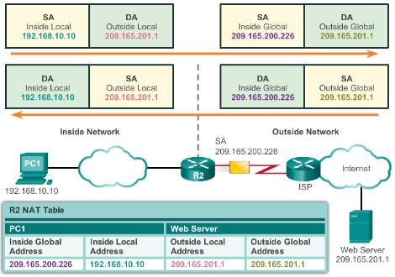
NAT Operation
NAT Characteristics
IPv4 Private Address Space
  10.0.0.0 /8, 172.16.0.0 /12, and 192.168.0.0 /16
What is NAT?
  Process to translate network IPv4 address
  Conserve public IPv4 addresses
  Configured at the border router for translation
NAT Terminology
  Inside address
  Inside local address
  Inside global address
  Outside address
  Outside local address
  Outside global address
Notes:
9.1 – NAT Operation
9.1.1 – NAT Characteristics

Slide 5
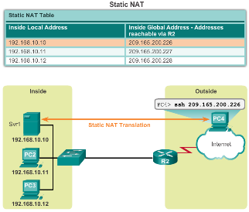
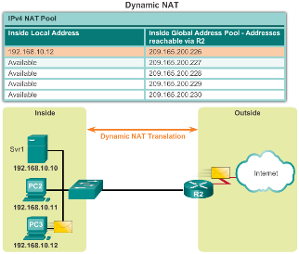
NAT Operation
Types of NAT
Static NAT
  One-to-one mapping of local and global addresses
  Configured by the network administrator and remain constant.
Dynamic NAT
  Uses a pool of public addresses and assigns them on a first-come, first-served basis
  Requires that enough public addresses for the total number of simultaneous user sessions
Port Address Translation (PAT)
  Maps multiple private IPv4 addresses to a single public IPv4 address or a few addresses
  Also known as NAT overload
  Validates that the incoming packets were requested
  Uses port numbers to forward the response packets to the correct internal device
Notes:
9.1 – NAT Operation
9.1.2 – Types of NAT

Slide 6
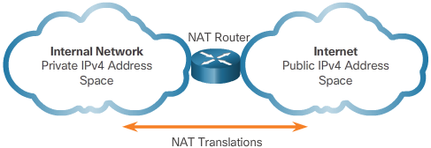
NAT Operation
NAT Advantages
Advantages of NAT
  Conserves the legally registered addressing scheme
  Increases the flexibility of connections to the public network
  Provides consistency for internal network addressing schemes
  Provides network security
Disadvantages of NAT
  Performance is degraded
  End-to-end functionality is degraded
  End-to-end IP traceability is lost
  Tunneling is more complicated
  Initiating TCP connections can be disrupted
Notes:
9.1 – NAT Operation
9.1.3 – NAT Advantages

Slide 7
4.2 Configuring NAT
Notes:
Cisco Networking Academy Program
Routing and Switching Essentials v6.0
Chapter 9: NAT for IPv4

Slide 8
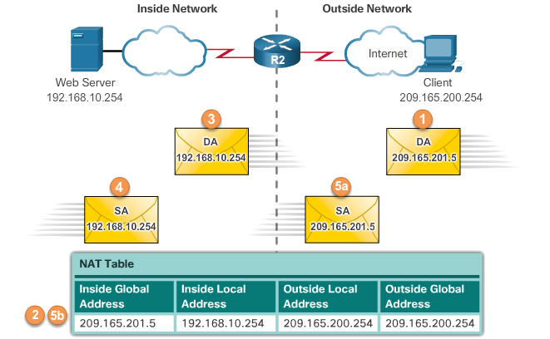
Configuring NAT
Configuring Static NAT
Configuring Static NAT
  Create the mapping between the inside local and outside local addresses
    ip nat inside source static local-ip global-ip
  Define which interfaces belong to the inside network and which belong to the outside network
    ip nat inside
    ip nat outside
Analyzing Static NAT
Verifying Static NAT
  show ip nat translations
  show ip nat statistics
  clear ip nat statistics
Notes:
9.2 – Configuring NAT
9.2.1 – Configuring Static NAT

Slide 9
Configuring NAT
Configuring Dynamic NAT
Dynamic NAT Operation
  The pool of public IPv4 addresses (inside global address pool) is available to any device on the inside network on a first-come, first-served basis.
  With dynamic NAT, a single inside address is translated to a single outside address.
  The pool must be large enough to accommodate all inside devices.
  A device is unable to communicate to any external networks if no addresses are available in the pool.
Notes:
9.2 – Configuring NAT
9.2.2 – Configuring Dynamic NAT

Slide 10
Configuring NAT
Configuring Dynamic NAT (Cont.)
Configuring Dynamic NAT
  Create the mapping between the inside local and outside local addresses
    ip nat pool name start-ip end-ip {netmask netmask | prefix-length prefix-length}
  Create a standard ACL to permit those addresses to be translated
    access-list access-list-number permit source [source-wildcard]
  Bind the ACL to the pool
    ip nat inside source list access-list-number pool name
  Identify the inside and outside interfaces
    ip nat inside
    ip nat outside
Notes:
9.2 – Configuring NAT
9.2.2 – Configuring Dynamic NAT

Slide 11
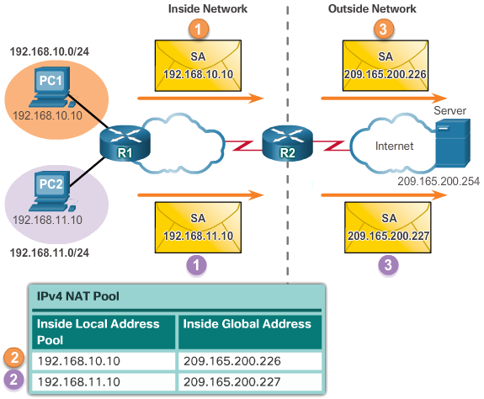
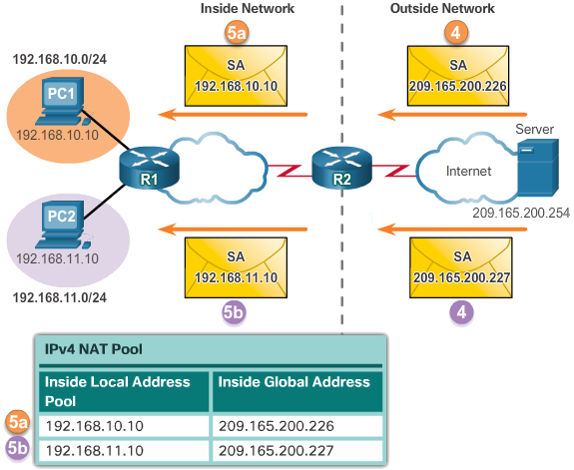
Configuring NAT
Configuring Dynamic NAT (Cont.)
Analyzing Dynamic NAT
Verifying Dynamic NAT
  show ip nat translations
  show ip nat translations verbose
  clear ip nat statistics
  clear ip nat translations *
Notes:
9.2 – Configuring NAT
9.2.2 – Configuring Dynamic NAT

Slide 12
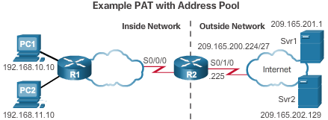
Configuring NAT
Configuring Port Address Translations (PAT)
Configuring PAT: Address Pool
  Create the mapping between the inside local and outside local addresses
    ip nat pool name start-ip end-ip {netmask netmask | prefix-length prefix-length}
  Create a standard ACL to permit those addresses to be translated
    access-list access-list-number permit source [source-wildcard]
  Bind the ACL to the pool
    ip nat inside source list access-list-number pool name
  Identify the inside and outside interfaces
    ip nat inside
    ip nat outside
Notes:
9.2 – Configuring NAT
9.2.3 – Configuring Port Address Translations (PAT)

Slide 13
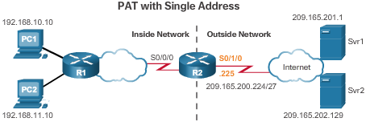
Configuring NAT
Configuring Port Address Translations (PAT) (Cont.)
Configuring PAT: Single Address
  Define a standard ACL to permit those addresses to be translated
    access-list access-list-number permit source [source-wildcard]
  Establish dynamic source translation, specify the ACL, exit interface, and overload option
    ip nat inside source list access-list-number interface type name overload
  Identify the inside and outside interfaces
    ip nat inside
    ip nat outside
Notes:
9.2 – Configuring NAT
9.2.3 – Configuring Port Address Translations (PAT)

Slide 14
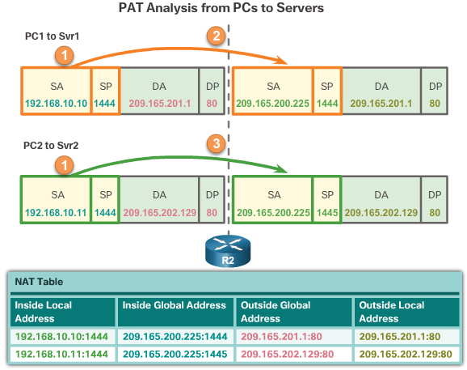
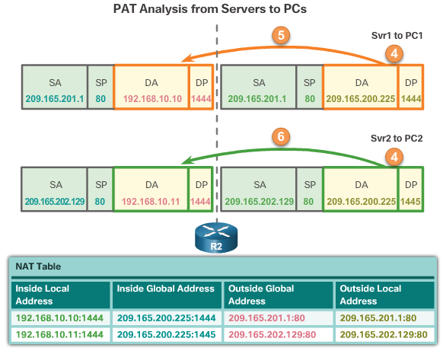
Configuring NAT
Configuring Port Address Translations (PAT) (Cont.)
Analyzing PAT
Verifying PAT
  show ip nat translations
  show ip nat statistics
  slear ip nat statistics
Notes:
9.2 – Configuring NAT
9.2.3 – Configuring Port Address Translations (PAT)

Slide 15
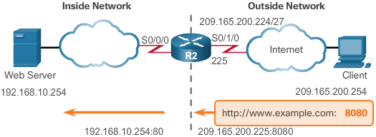
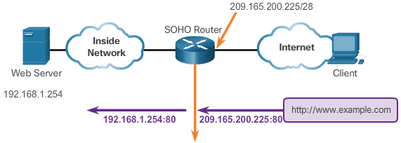
Configuring NAT
Port Forwarding
Port Forwarding
  Port forwarding is the act of forwarding a network port from one network node to another.
  A packet sent to the public IP address and port of a router can be forwarded to a private IP address and port in inside network.
  Port forwarding is helpful in situations where servers have private addresses, not reachable from the outside networks.
Wireless Router Example
Configuring Port Forwarding with IOS
  ip nat inside source [static {tcp | udp local-ip local-port global-ip global-port} [extendable]
Notes:
9.2 – Configuring NAT
9.2.4 – Port Forwarding

Slide 16
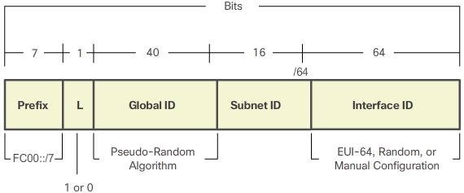
Configuring NAT
Configuring NAT and IPv6
NAT for IPv6?
  IPv6 with a 128-bit address provides 340 undecillion addresses.
  Address space is not an issue for IPv6.
  IPv6 makes IPv4 public-private NAT unnecessary by design; however, IPv6 does implement a form of private addresses, and it is implemented differently than they are for IPv4.
IPv6 Unique Local Address
  IPv6 unique local addresses (ULAs) are designed to allow IPv6 communications within a local site.
  ULAs are not meant to provide additional IPv6 address space.
  ULAs have the prefix FC00::/7, which results in a first hextet range of FC00 to FDFF.
  ULAs are also known as local IPv6 addresses (not to be confused with IPv6 link-local addresses).
Notes:
9.2 – Configuring NAT
9.2.5 – Configuring NAT and IPv6

Slide 17
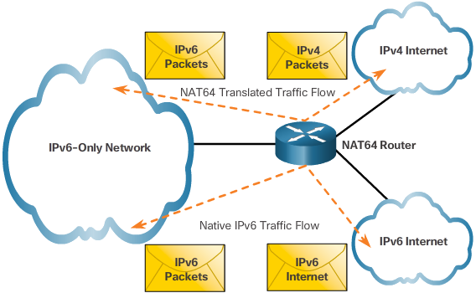
Configuring NAT
Configuring NAT and IPv6 (Cont.)
NAT for IPv6
  IPv6 also uses NAT, but in a much different context.
  In IPv6, NAT is used to provide transparent communication between IPv6 and IPv4.
  NAT64 is not intended to be a permanent solution; it is meant to be a transition mechanism.
  Network Address Translation-Protocol Translation (NAT-PT) was another NAT-based transition mechanism for IPv6, but is now deprecated by IETF.
  NAT64 is now recommended.
Notes:
9.2 – Configuring NAT
9.2.5 – Configuring NAT and IPv6

Slide 18
4.3 Troubleshooting NAT
Notes:
Cisco Networking Academy Program
Routing and Switching Essentials v6.0
Chapter 9: NAT for IPv4

Slide 19
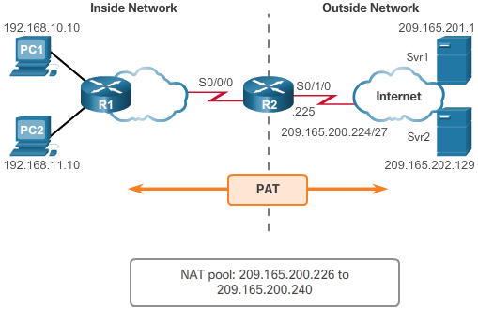
Troubleshooting NAT
Troubleshooting NAT Configurations
Troubleshooting NAT: show commands
  clear ip nat statistics
  clear ip nat translations *
  show ip nat statistics
  Show ip nat translations
Troubleshooting NAT: debug commands
  debug ip nat
Notes:
9.3 – Troubleshooting NAT
9.3.1 – Troubleshooting NAT Configurations

Slide 20
4.4 Chapter Summary
Notes:
Cisco Networking Academy Program
Routing and Switching Essentials v6.0
Chapter 9: NAT for IPv4

Slide 21
Chapter 11 Summary
Summary
How NAT is used to help alleviate the depletion of the IPv4 address space.
NAT conserves public address space and saves considerable administrative overhead in managing adds, moves, and changes.
NAT for IPv4, including:
  NAT characteristics, terminology, and general operations
  Different types of NAT, including static NAT, dynamic NAT, and NAT with overloading
  Benefits and disadvantages of NAT
The configuration, verification, and analysis of static NAT, dynamic NAT, and NAT with overloading.
How port forwarding can be used to access an internal devices from the Internet.
Troubleshooting NAT using show and debug commands.
How NAT for IPv6 is used to translate between IPv6 addresses and IPv4 addresses.
Notes:
9.4.1 - Summary

